Slide 1
Breadth-First Search (BFS)

Slide 2
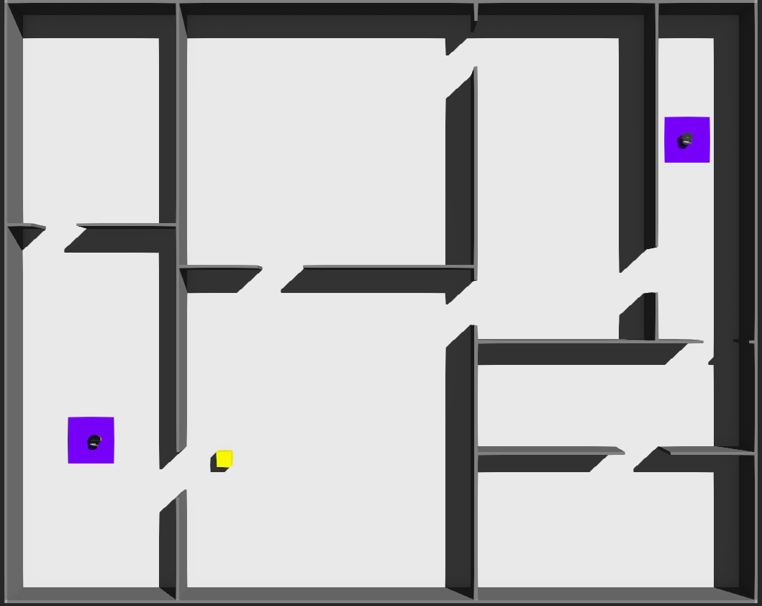
Notes:
Mention how to return back to start

Slide 3
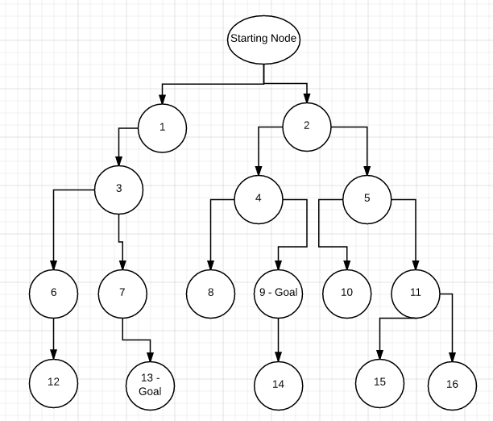
edge
node
Notes:
Mention how to return back to start

Slide 4
Empty Queue
1
3
-2
1
push()
front()
pop()
Notes:
Mention how to return back to start

Slide 5
Parent Array
Start: 0
1: 0
2: 0
3: 0
4: 0
5: 0
6: 0
7: 0
8: 0
9: 0
10: 0
11: 0
12: 0
13: 0
14: 0
15: 0
16: 0
Parent Array
Start: Start
1: 0
2: 0
3: 0
4: 0
5: 0
6: 0
7: 0
8: 0
9: 0
10: 0
11: 0
12: 0
13: 0
14: 0
15: 0
16: 0
Parent Array
Start: Start
1: Start
2: Start
3: 0
4: 0
5: 0
6: 0
7: 0
8: 0
9: 0
10: 0
11: 0
12: 0
13: 0
14: 0
15: 0
16: 0
Parent Array
Start: Start
1: Start
2: Start
3: 1
4: 0
5: 0
6: 0
7: 0
8: 0
9: 0
10: 0
11: 0
12: 0
13: 0
14: 0
15: 0
16: 0
Parent Array
Start: Start
1: Start
2: Start
3: 1
4: 2
5: 2
6: 0
7: 0
8: 0
9: 0
10: 0
11: 0
12: 0
13: 0
14: 0
15: 0
16: 0
Parent Array
Start: Start
1: Start
2: Start
3: 1
4: 2
5: 2
6: 3
7: 3
8: 0
9: 0
10: 0
11: 0
12: 0
13: 0
14: 0
15: 0
16: 0
Parent Array
Start: Start
1: Start
2: Start
3: 1
4: 2
5: 2
6: 3
7: 3
8: 4
9: 4
10: 0
11: 0
12: 0
13: 0
14: 0
15: 0
16: 0
Queue
Start
Queue
3
Queue
4, 5, 6, 7
Queue
Empty
Queue
1, 2
Queue
2
Queue
2, 3
Queue
4, 5
Queue
5, 6, 7, 8, 9
Queue
Empty
Queue
3, 4, 5
Queue
5, 6, 7
Current Node: 0
Current Node: Start
Current Node: 1
Current Node: 2
Current Node: 3
Current Node: 4
Notes:
Mention how to return back to start

Slide 6
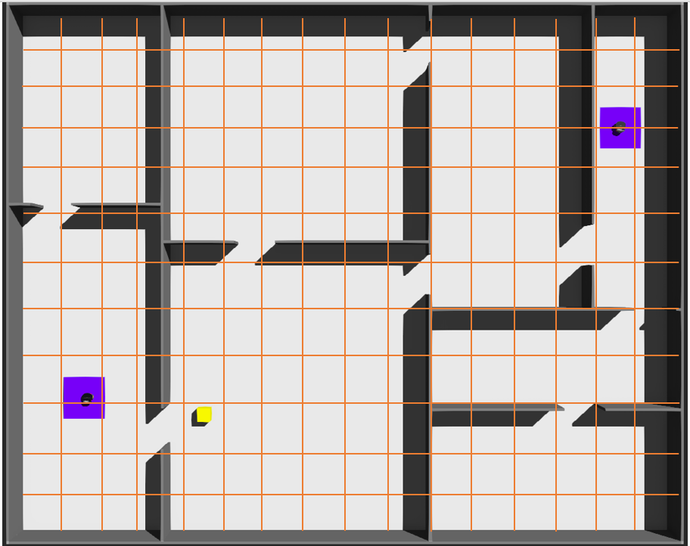

Slide 7
Start
While BFS can find a path
Get Surroundings (Fill out map)
Breadth-First Search (Push path into function queue)
Grab Victim
Return to Base
Victim?
Move 1 Tile
End
While function queue is not empty

